Slide 1
St. Louis Central Corridor West Building Permits
Monthly Report: January 2021

Slide 2
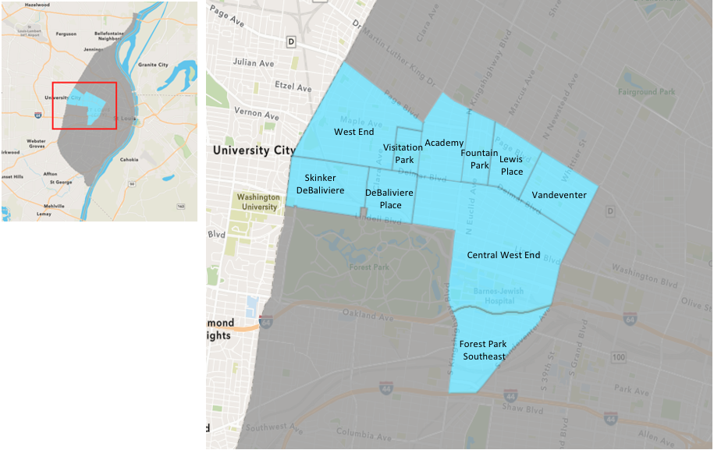
St. Louis Neighborhood Spatial Reference

Slide 3
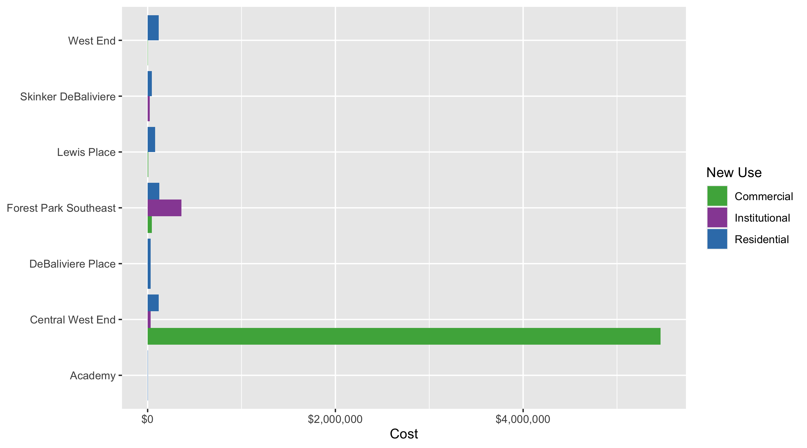
Neighborhood Summary: Average Building Permit Cost

Slide 4
Neighborhood Summary
January 2021 | January 2021 | January 2021 | January 2021
Neighborhood | Average Cost | # of Permits | Total Value of Permits
Academy | 4,475.0 | 1.0 | 4,475.0
Central West End | 1,169,698.9 | 30.0 | 35,090,968.0
DeBaliviere Place | 31,734.7 | 3.0 | 95,204.0
Forest Park Southeast | 142,122.9 | 23.0 | 3,268,827.0
Fountain Park | 0.0 | 0.0 | 0.0
Lewis Place | 54,866.7 | 3.0 | 164,600.0
Skinker DeBaliviere | 42,478.0 | 14.0 | 594,692.0
Vandeventer | 0.0 | 0.0 | 0.0
Visitation Park | 0.0 | 0.0 | 0.0
West End | 101,309.6 | 7.0 | 709,167.0
Last 6 Months | Last 6 Months | Last 6 Months | Last 6 Months
Neighborhood | Average Cost | # of Permits | Total Value of Permits
Academy | 25,197.6 | 23 | 579,544.0
Central West End | 433,491.6 | 217 | 94,067,668.0
DeBaliviere Place | 358,266.7 | 36 | 12,897,601.0
Forest Park Southeast | 3,904,529.0 | 85 | 331,884,968.0
Fountain Park | 102,500.0 | 2 | 205,000.0
Lewis Place | 32,724.9 | 17 | 556,323.0
Skinker DeBaliviere | 59,211.9 | 60 | 3,552,714.0
Vandeventer | 35,219.1 | 9 | 316,972.0
Visitation Park | 20,554.5 | 4 | 82,218.0
West End | 84,106.0 | 51 | 4,289,407.0

Slide 5
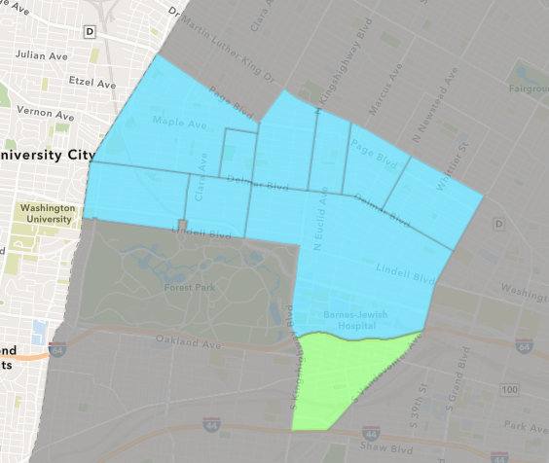
Forest Park Southeast
January 2021 Neighborhood Cost Breakdown
Mean: $142,123
Median: $140,000
Range: $1,200 - $863,907

Slide 6
Forest Park Southeast: Summary Notes
23 building permits in January 2021
155.56% change compared to January 2020 (9 total building permits)
$142,123: Average building permit cost in January 2021
134.21% change compared to January 2020 ($60,682)
23 total building permits in 2021
155.56% change YTD compared to this time in 2020 (9 total building permits)
$142,123: YTD average building permit cost in 2021
134.21% change YTD compared to this time in 2020 ($60,682)

Slide 7
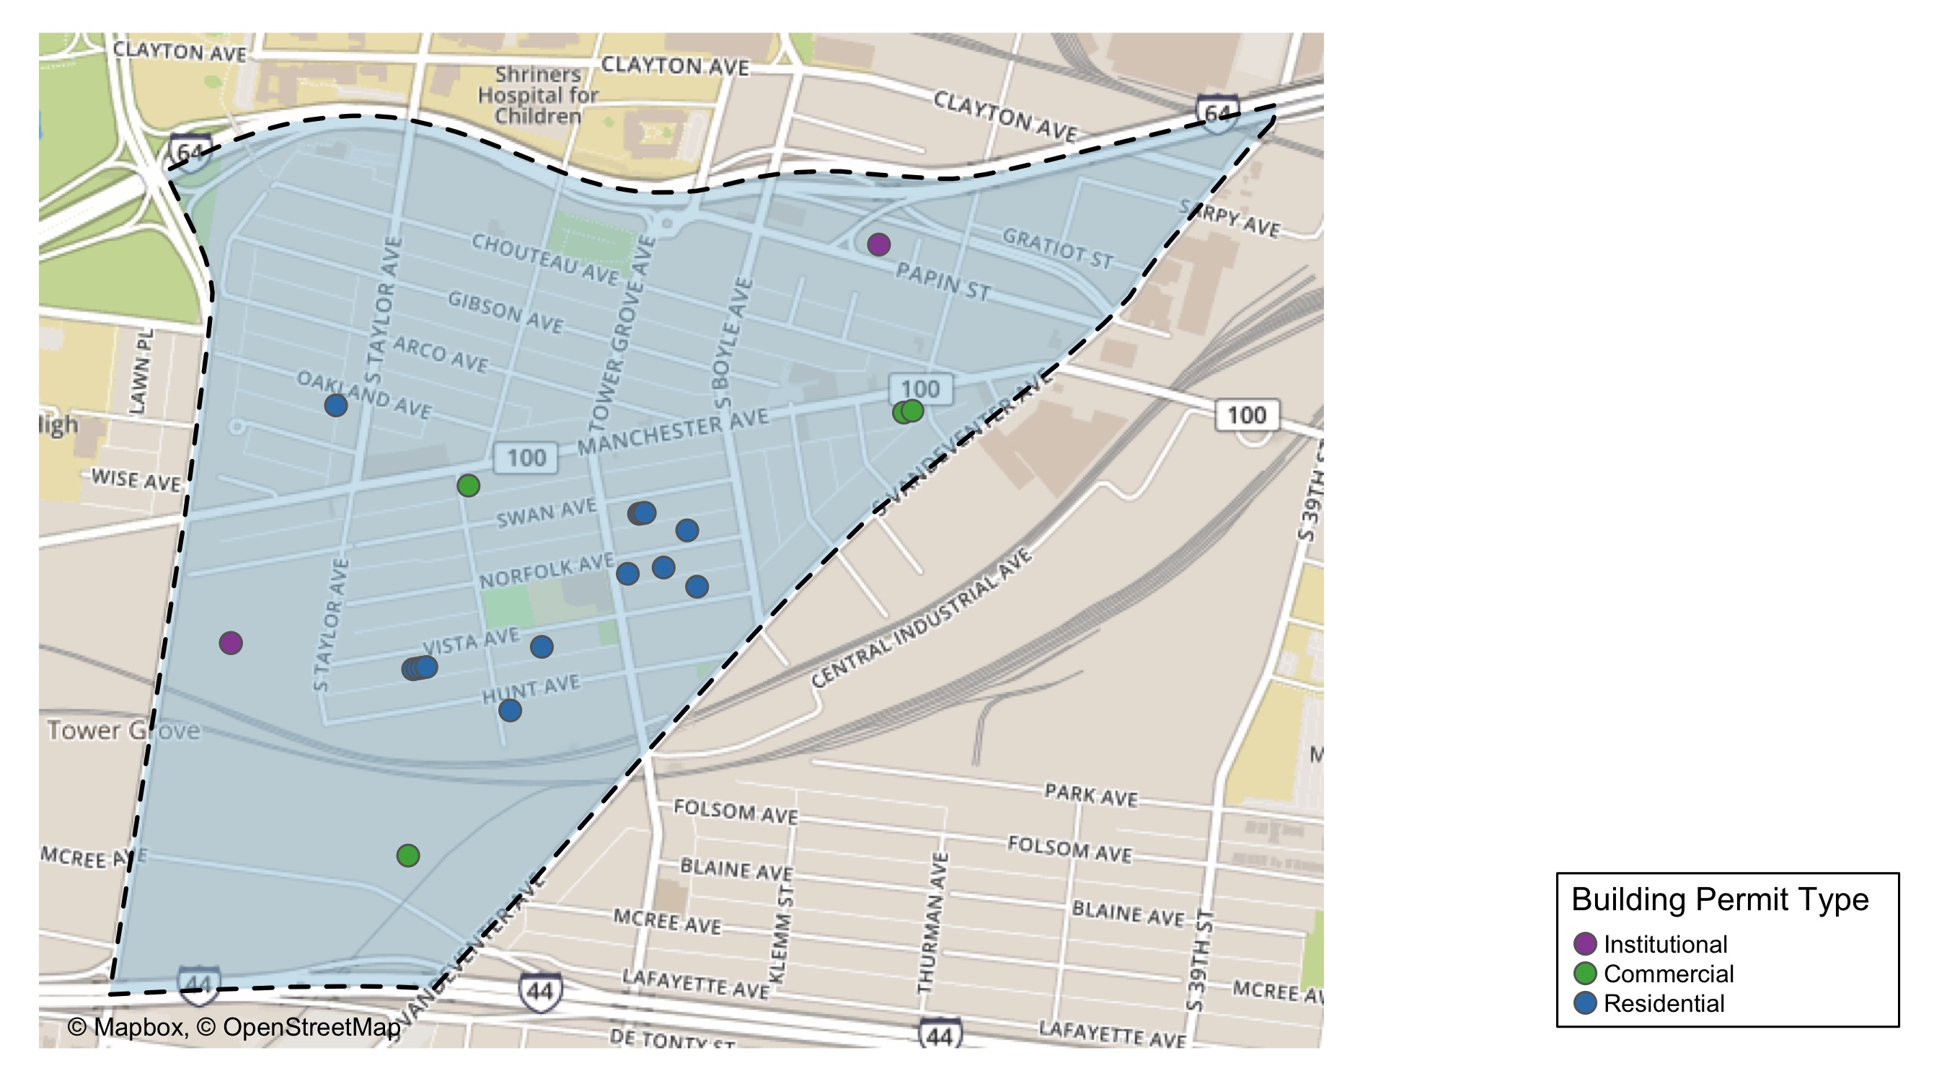
Forest Park Southeast

Slide 8
Neighborhood Summary
January 2021 | January 2021 | January 2021 | January 2021
Permit Use | Average Cost | # of Permits | Total Value of Permits
Commercial | 45,292.8 | 4.0 | 181,171.0
Industrial | 0.0 | 0.0 | 0.0
Institutional | 358,501.0 | 3.0 | 1,075,503.0
Residential | 125,759.6 | 16.0 | 2,012,153.0
Last 6 Months | Last 6 Months | Last 6 Months | Last 6 Months
Permit Use | Average Cost | # of Permits | Total Value of Permits
Commercial | 87,957.1 | 17 | 1,495,271.0
Industrial | 6,100.0 | 1 | 6,100.0
Institutional | 568,655.2 | 10 | 5,686,552.0
Residential | 5,696,439.4 | 57 | 324,697,045.0

Slide 9
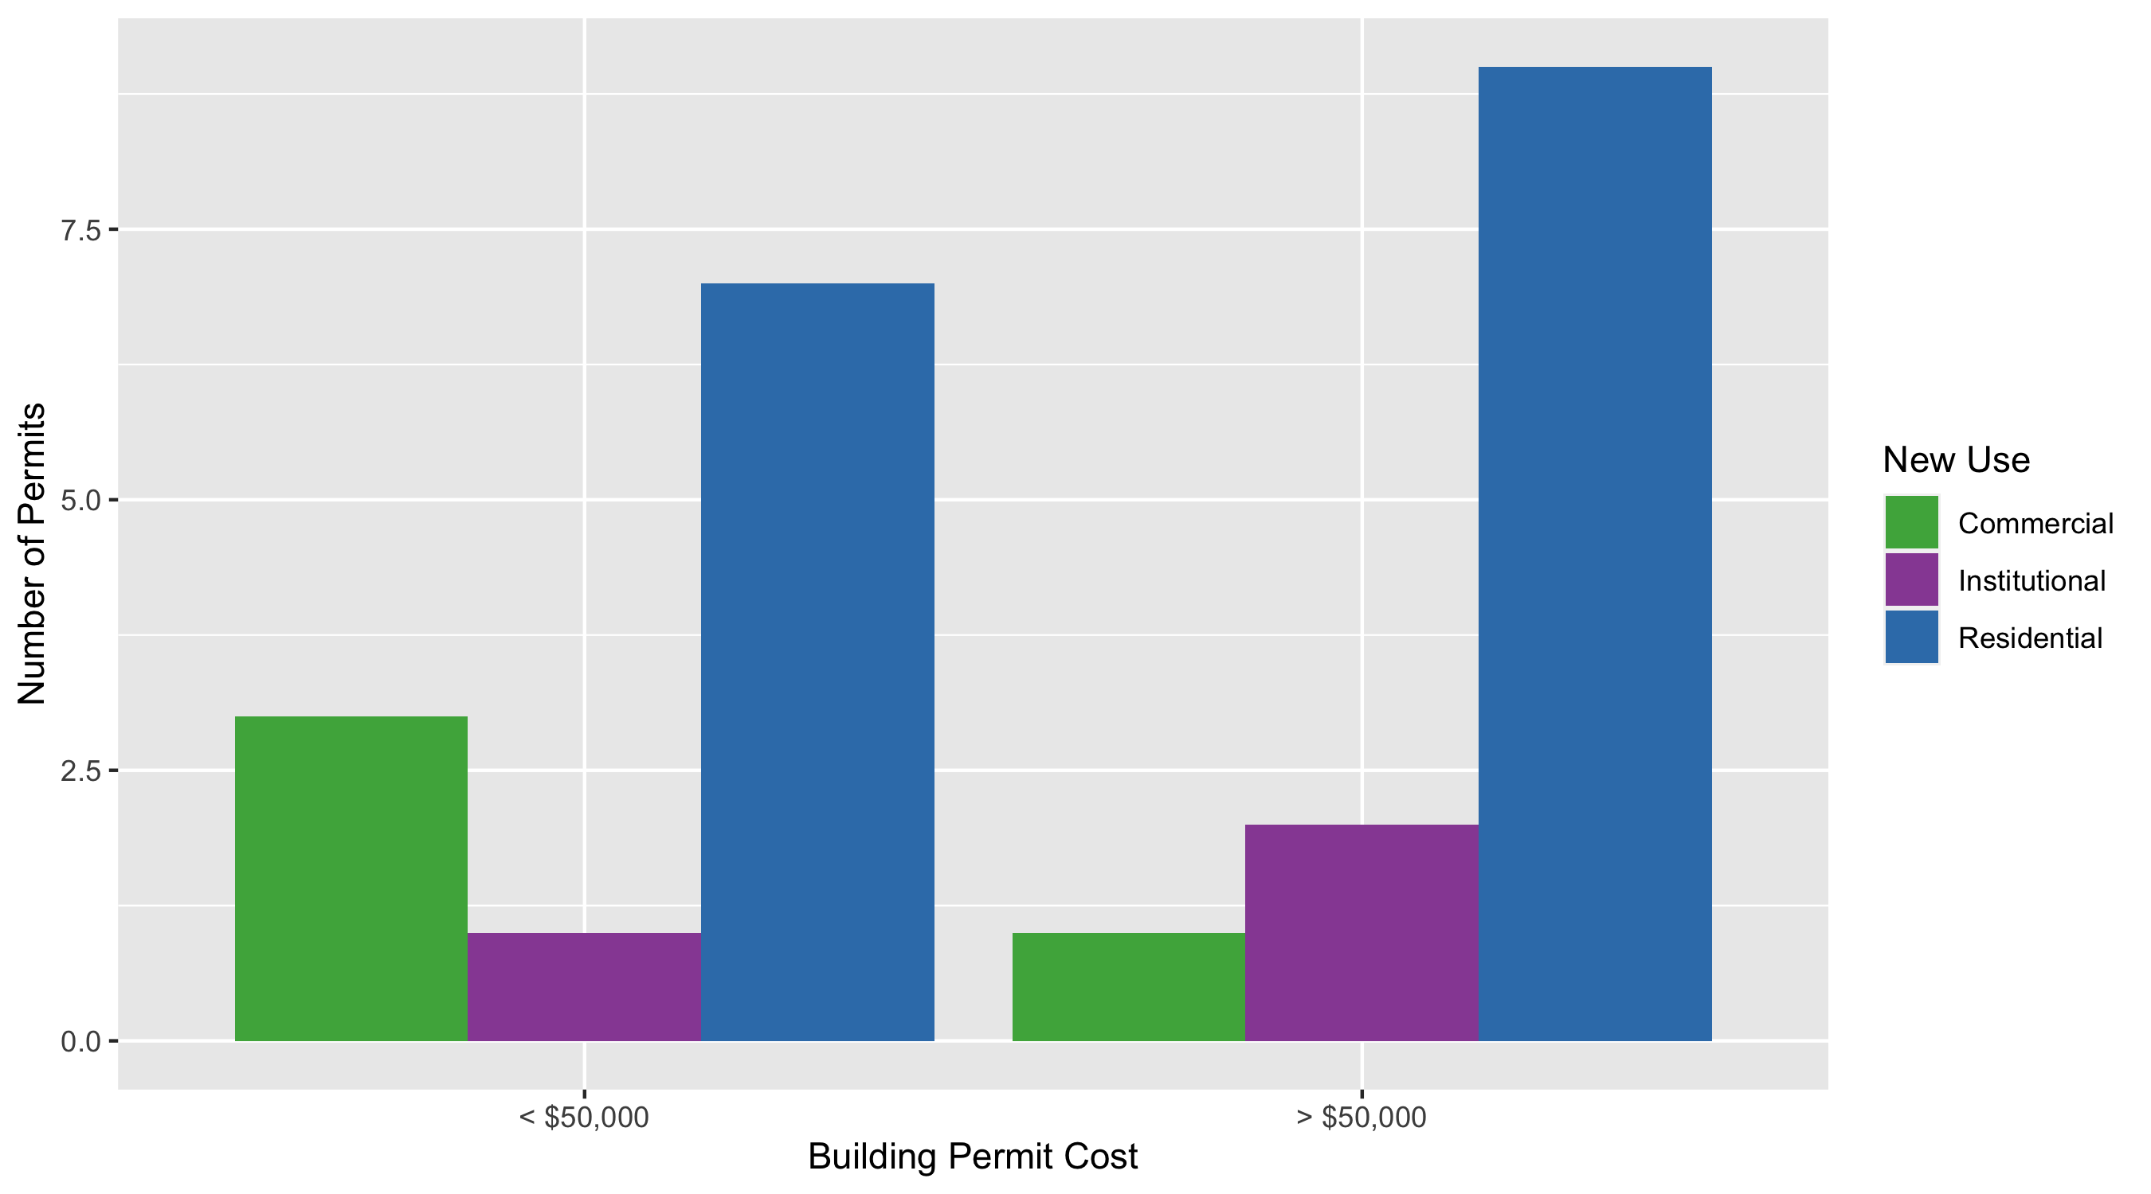
Forest Park Southeast Permit Cost Breakdown

Slide 10
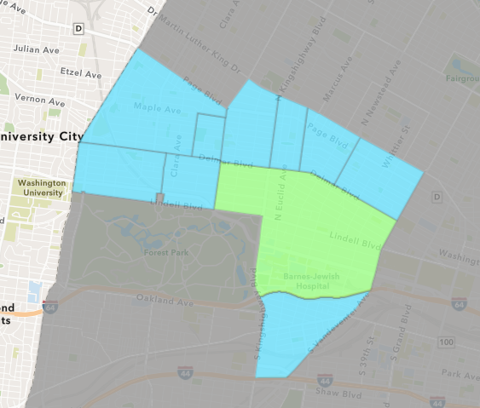
Central West End
January 2021 Neighborhood Cost Breakdown
Mean: $1,169,699
Median: $32,194
Range: $1,500 - $32,034,233

Slide 11
Central West End: Summary Notes
30 building permits in January 2021
-14.29% change compared to January 2020 (35 total building permits)
$1,169,699: Average building permit cost in January 2021
135.27% change compared to January 2020 ($497,175)
30 total building permits in 2021
-14.29% change YTD compared to this time in 2020 (35 total building permits)
$1,169,699: YTD average building permit cost in 2021
135.27% change YTD compared to this time in 2020 ($497,175)

Slide 12
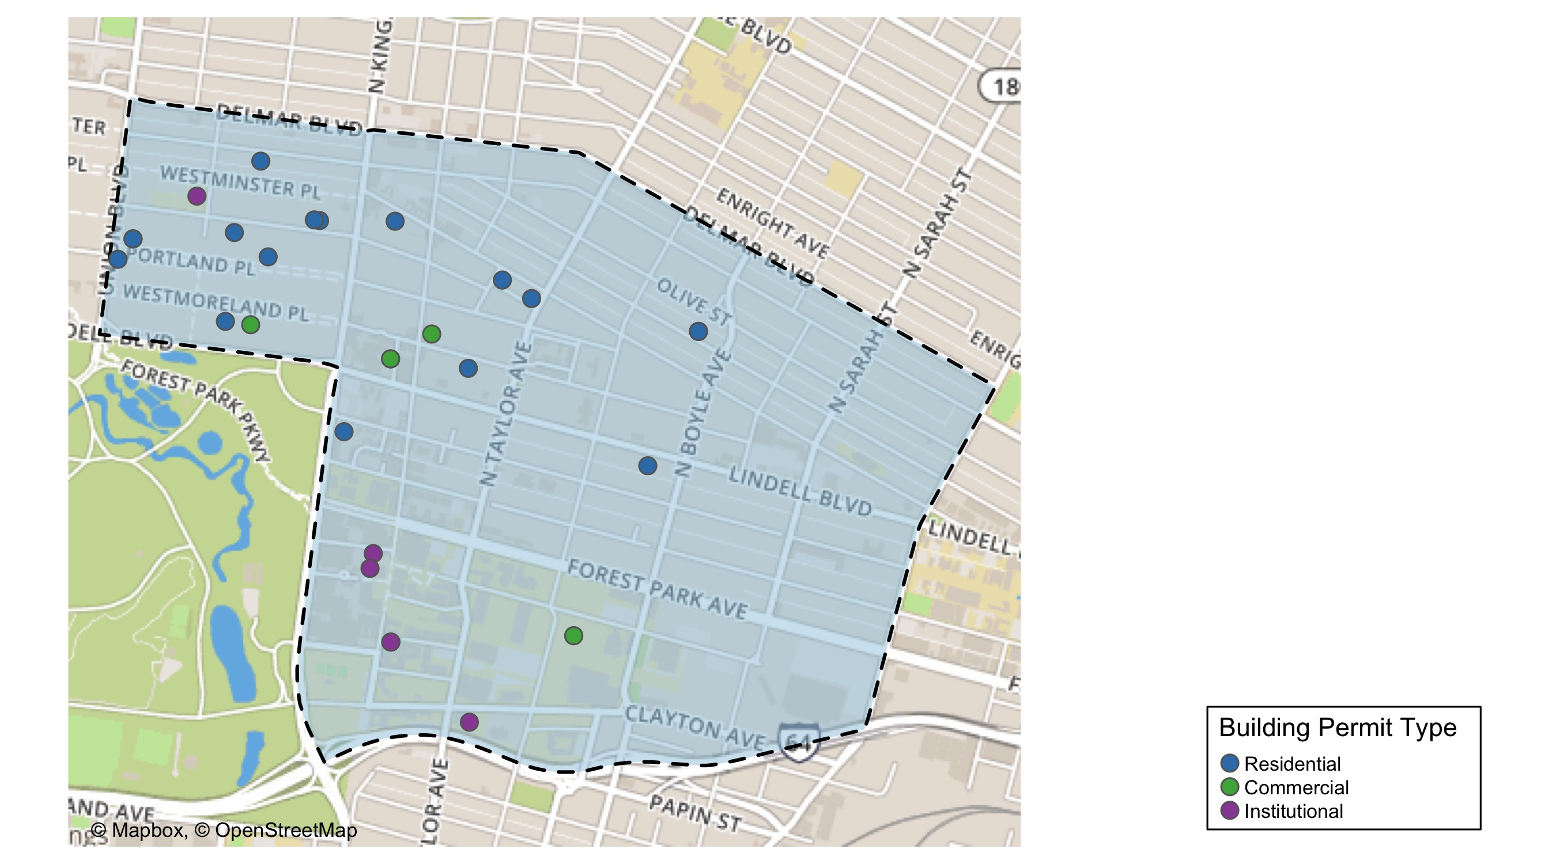
Central West End

Slide 13
Central West End
January 2021 | January 2021 | January 2021 | January 2021
Permit Use | Average Cost | # of Permits | Total Value of Permits
Commercial | 5,462,656.3 | 6.0 | 32,775,938.0
Industrial | 0.0 | 0.0 | 0.0
Institutional | 30,695.0 | 6.0 | 184,170.0
Residential | 118,381.1 | 18.0 | 2,130,860.0
Last 6 Months | Last 6 Months | Last 6 Months | Last 6 Months
Permit Use | Average Cost | # of Permits | Total Value of Permits
Commercial | 979,260.8 | 36.0 | 35,253,387.0
Industrial | 0.0 | 0.0 | 0.0
Institutional | 249,405.1 | 63.0 | 15,712,522.0
Residential | 365,269.1 | 118.0 | 43,101,759.0

Slide 14
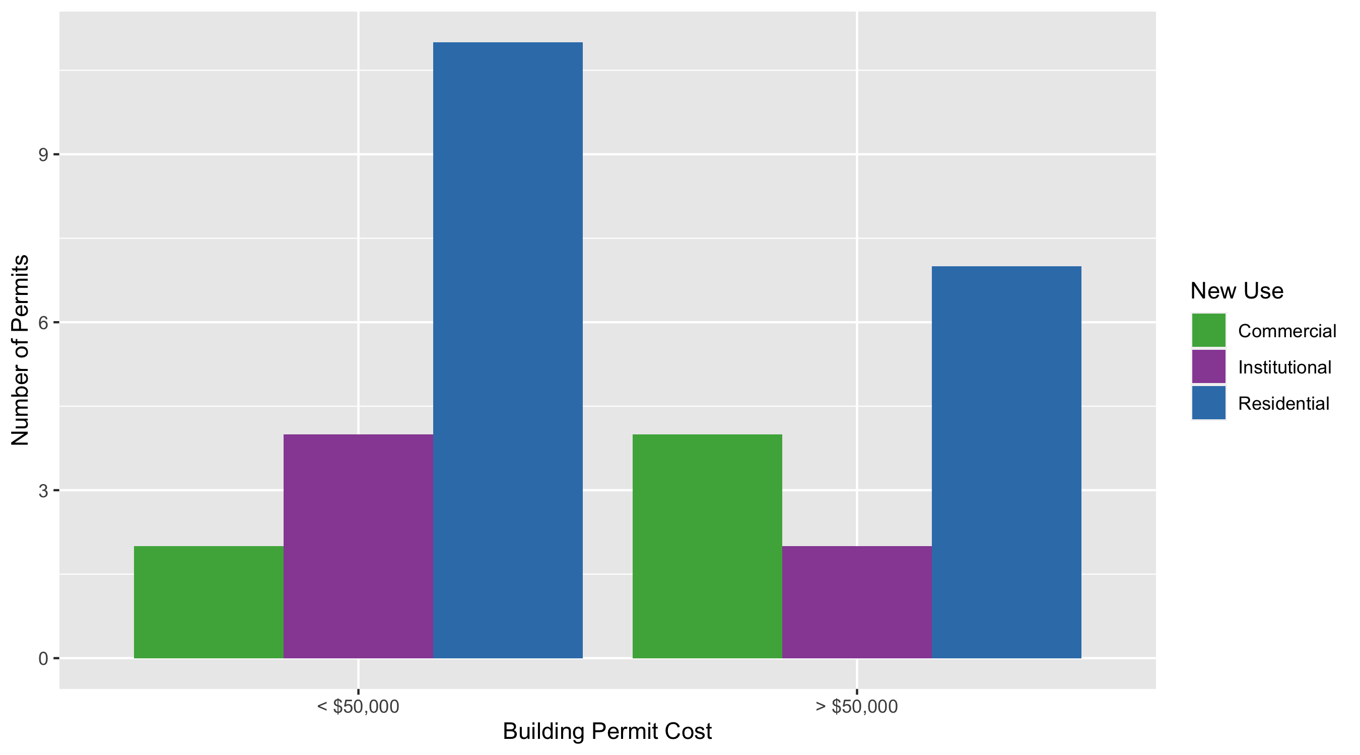
Cental West End Permit Cost Breakdown

Slide 15
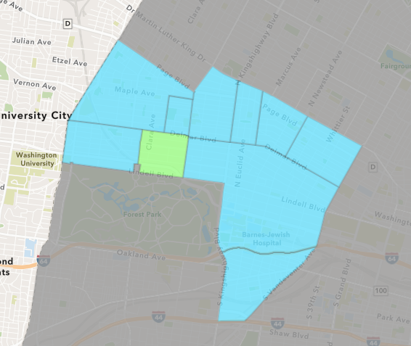
DeBaliviere Place
January 2021 Neighborhood Cost Breakdown
Mean: $31,735
Median: $30,000
Range: $13,854 - $51,350

Slide 16
DeBaliviere Place: Summary Notes
3 building permits in January 2021
-25.00% change compared to January 2020 (4 total building permits)
$31,735: Average building permit cost in January 2021
-99.30% change compared to January 2020 ($4,512,000)
3 total building permits in 2021
-25.00% change YTD compared to this time in 2020 (4 total building permits)
$31,735: YTD average building permit cost in 2021
-99.30% change YTD compared to this time in 2020 ($4,512,000)

Slide 17
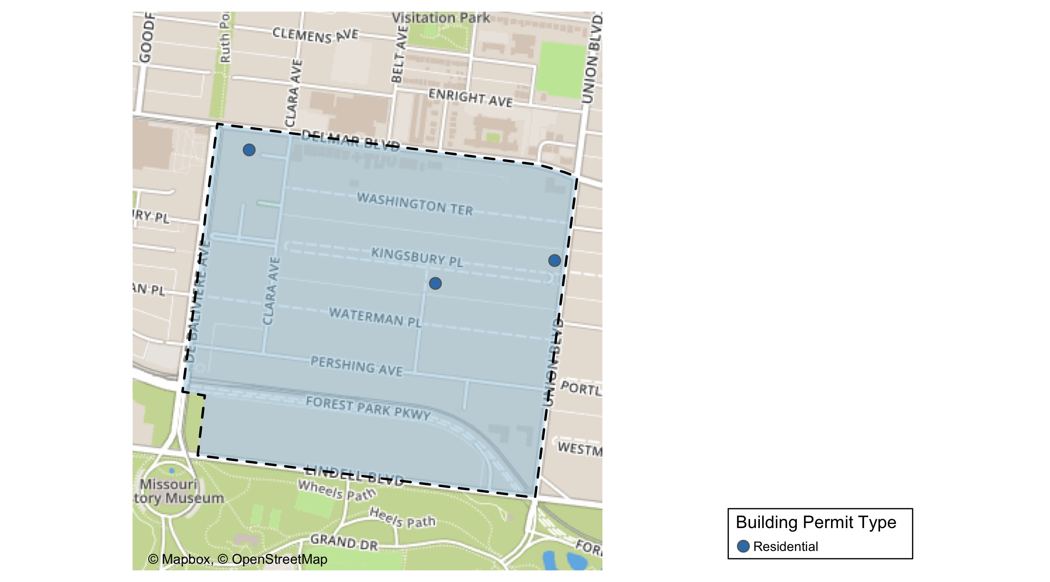
DeBaliviere Place

Slide 18
DeBaliviere Place
January 2021 | January 2021 | January 2021 | January 2021
Permit Use | Average Cost | # of Permits | Total Value of Permits
Commercial | 0.0 | 0.0 | 0.0
Industrial | 0.0 | 0.0 | 0.0
Institutional | 0.0 | 0.0 | 0.0
Residential | 31,734.7 | 3.0 | 95,204.0
Last 6 Months | Last 6 Months | Last 6 Months | Last 6 Months
Permit Use | Average Cost | # of Permits | Total Value of Permits
Commercial | 7,890.0 | 2.0 | 15,780.0
Industrial | 0.0 | 0.0 | 0.0
Institutional | 0.0 | 0.0 | 0.0
Residential | 378,877.1 | 34.0 | 12,881,821.0

Slide 19
DeBaliviere Place Individual Permit Breakdown
Owner | New Use | Cost | Address
BUFORD, JAMES H & SUSAN E | Residential | 13,854.0 | 1 KINGSBURY PL
DEL MONTE APARTMENTS LLC | Residential | 30,000.0 | 5622 DELMAR BLVD
GREGORY, PETER | Residential | 51,350.0 | 22 KINGSBURY PL

Slide 20
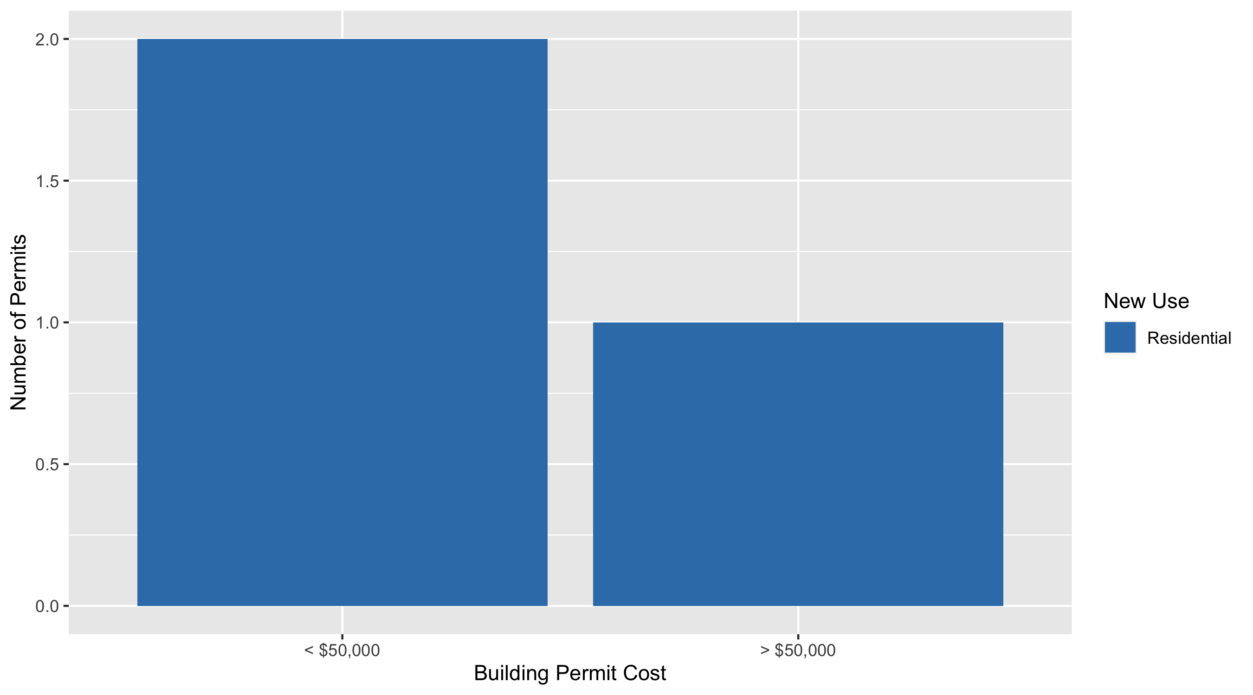
DeBaliviere Place Permit Cost Breakdown

Slide 21
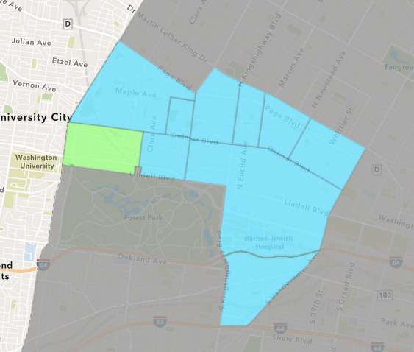
Skinker DeBaliviere
January 2021 Neighborhood Cost Breakdown
Mean: $42,478
Median: $26,000
Range: $400 - $200,000

Slide 22
Skinker DeBaliviere: Summary Notes
14 building permits in January 2021
100.00% change compared to January 2020 (7 total building permits)
$42,478: Average building permit cost in January 2021
54.07% change compared to January 2020 ($27,571)
14 total building permits in 2021
100.00% change YTD compared to this time in 2020 (7 total building permits)
$42,478: YTD average building permit cost in 2021
54.07% change YTD compared to this time in 2020 ($27,571)

Slide 23
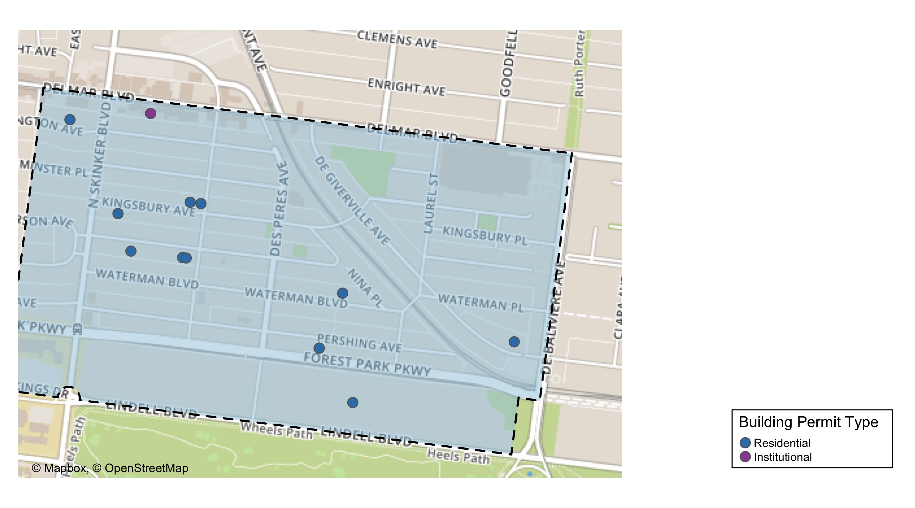
Skinker DeBaliviere

Slide 24
Skinker DeBaliviere
January 2021 | January 2021 | January 2021 | January 2021
Permit Use | Average Cost | # of Permits | Total Value of Permits
Commercial | 0.0 | 0.0 | 0.0
Industrial | 0.0 | 0.0 | 0.0
Institutional | 21,124.0 | 2.0 | 42,248.0
Residential | 46,037.0 | 12.0 | 552,444.0
Last 6 Months | Last 6 Months | Last 6 Months | Last 6 Months
Permit Use | Average Cost | # of Permits | Total Value of Permits
Commercial | 86,067.5 | 8.0 | 688,540.0
Industrial | 0.0 | 0.0 | 0.0
Institutional | 215,724.8 | 6.0 | 1,294,349.0
Residential | 34,126.6 | 46.0 | 1,569,825.0

Slide 25
Skinker DeBaliviere Individual Permit Breakdown
Owner | New Use | Cost | Address
RUDLOFF, MARY ANNE TRSTE | Residential | 18,297.0 | 6115 KINGSBURY AV
JACOBS, MARK I & CHANAYA N | Residential | 25,000.0 | 6229 WASHINGTON AV
BURTON, KENNETH W & PATRICIA J | Residential | 30,000.0 | 6101 KINGSBURY AV
KURTZ, PAUL B & KATHERINE N | Residential | 6,300.0 | 6178 KINGSBURY AV
LUTJENS, JEFFREY K | Residential | 400.0 | 5727 DEGIVERVILLE AV
THOMPSON, GREGG MICHAEL & | Residential | 35,000.0 | 6160 MCPHERSON AV
ONE WORLD USA LLC | Residential | 80,000.0 | 5912 PERSHING AV
COLETTE EDSON | Residential | 5,447.0 | 6108 MCPHERSON AV
CHURCH BUILDING LLC | Institutional | 15,248.0 | 6166 DELMAR BLVD
WEIS, KIRSTEN & RAVI CHOPRA | Residential | 30,000.0 | 6112 MCPHERSON AV
SAMUELS, DAVID & VICTORIA | Residential | 200,000.0 | 5835 LINDELL BLVD
MENDICINO ENTERPRISES LLC | Residential | 120,000.0 | 5857 WATERMAN BLVD
ONE WORLD USA LLC | Residential | 2,000.0 | 5912 PERSHING AV
CHURCH BUILDING LLC | Institutional | 27,000.0 | 6166 DELMAR BLVD

Slide 26
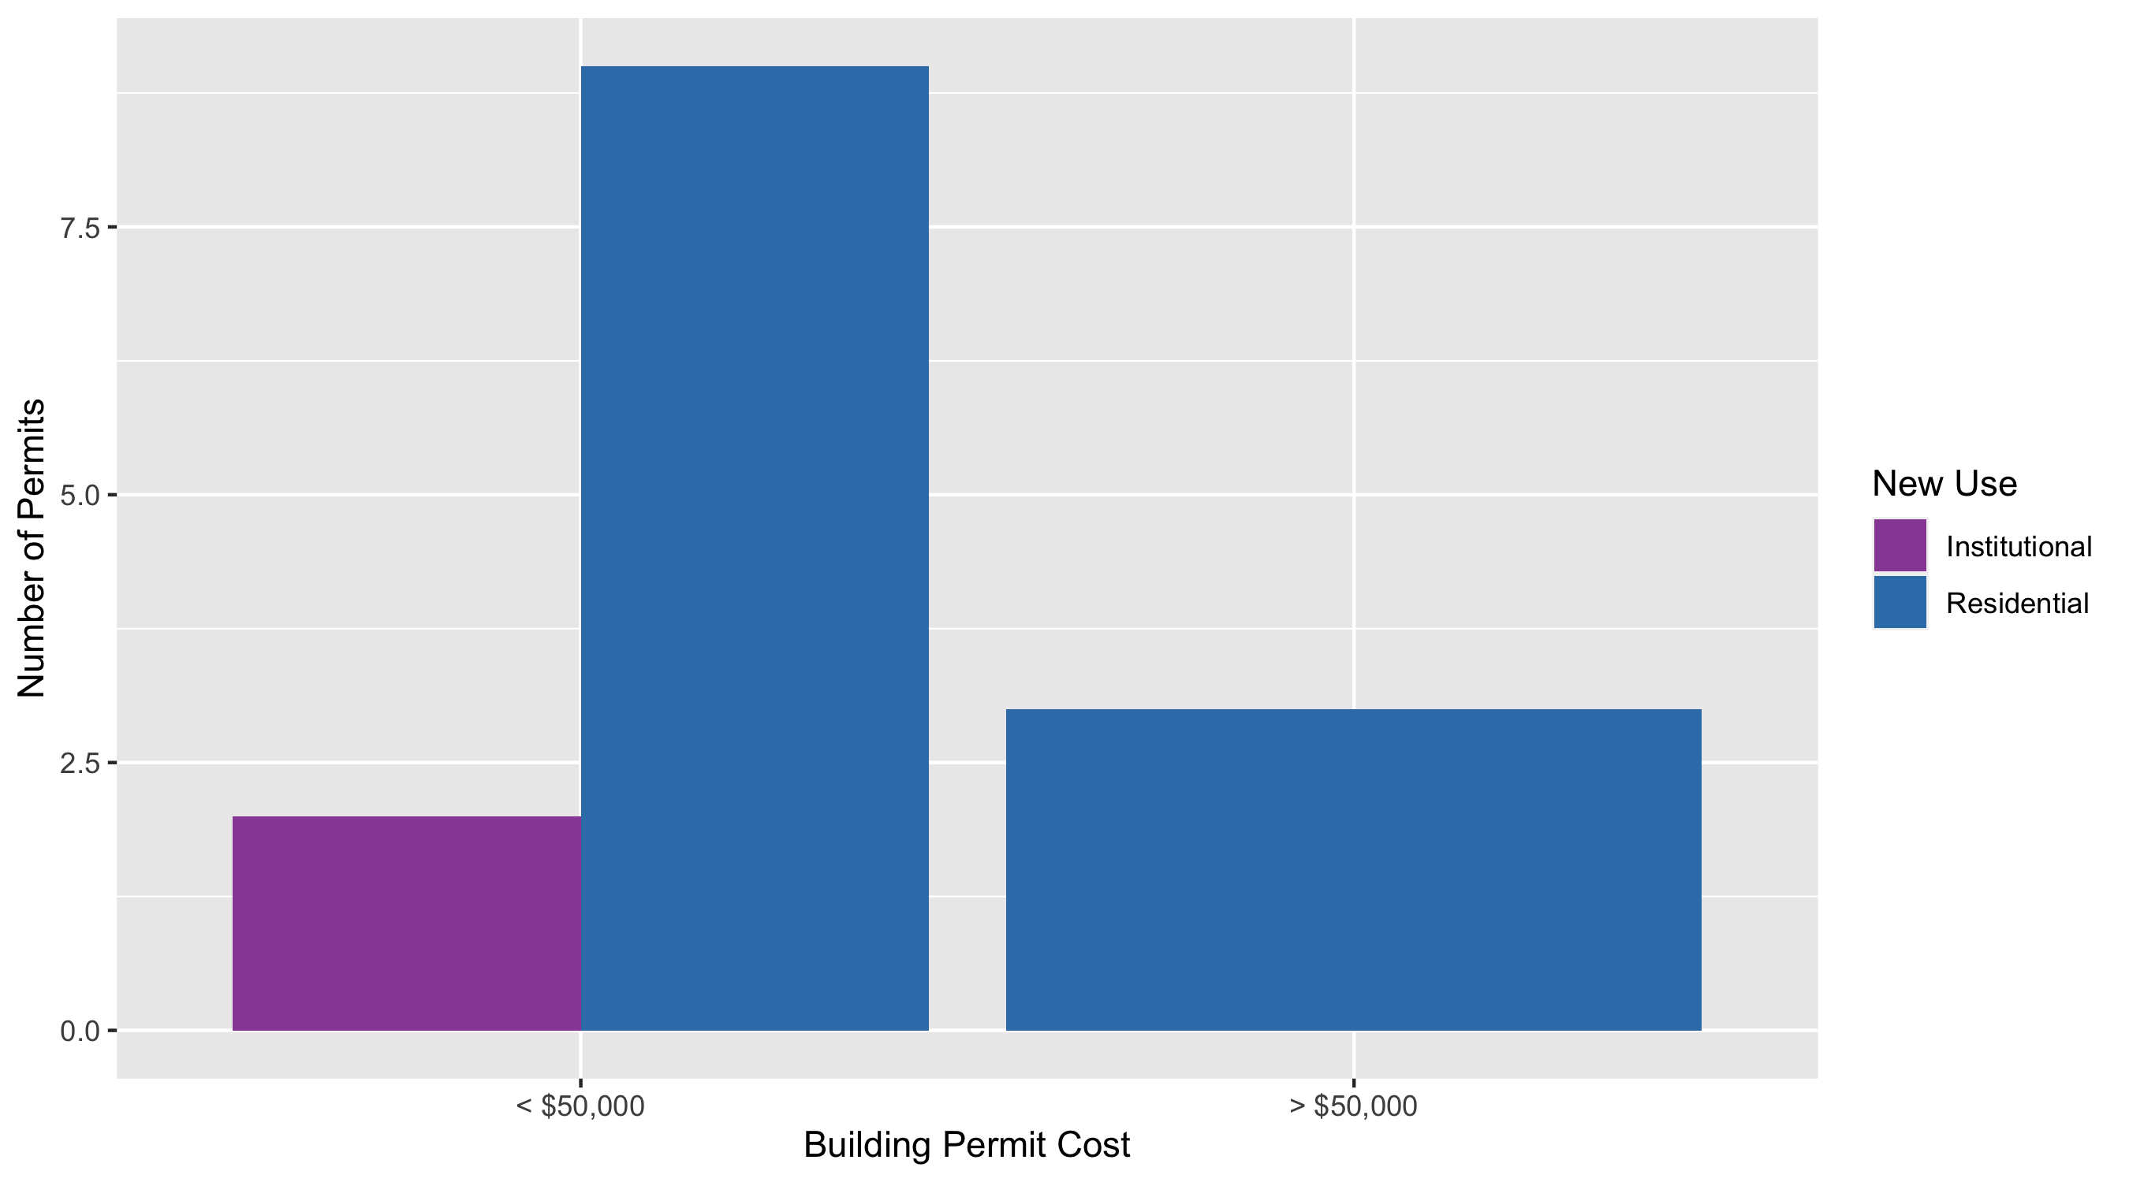
Skinker DeBaliviere Permit Cost Breakdown

Slide 27
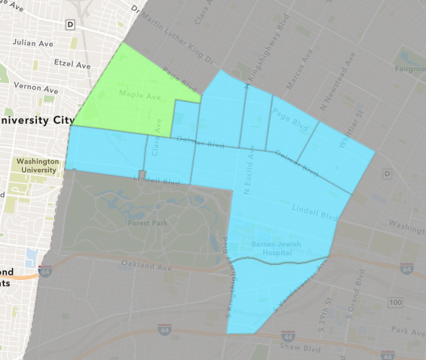
West End
January 2021 Neighborhood Cost Breakdown
Mean: $101,310
Median: $9,500
Range: $4,000 - $590,847

Slide 28
West End: Summary Notes
7 building permits in January 2021
-30.00% change compared to January 2020 (10 total building permits)
$101,310: Average building permit cost in January 2021
1166.37% change compared to January 2020 ($8,000)
7 total building permits in 2021
-30.00% change YTD compared to this time in 2020 (10 total building permits)
$101,310: YTD average building permit cost in 2021
1166.37% change YTD compared to this time in 2020 ($8,000)

Slide 29
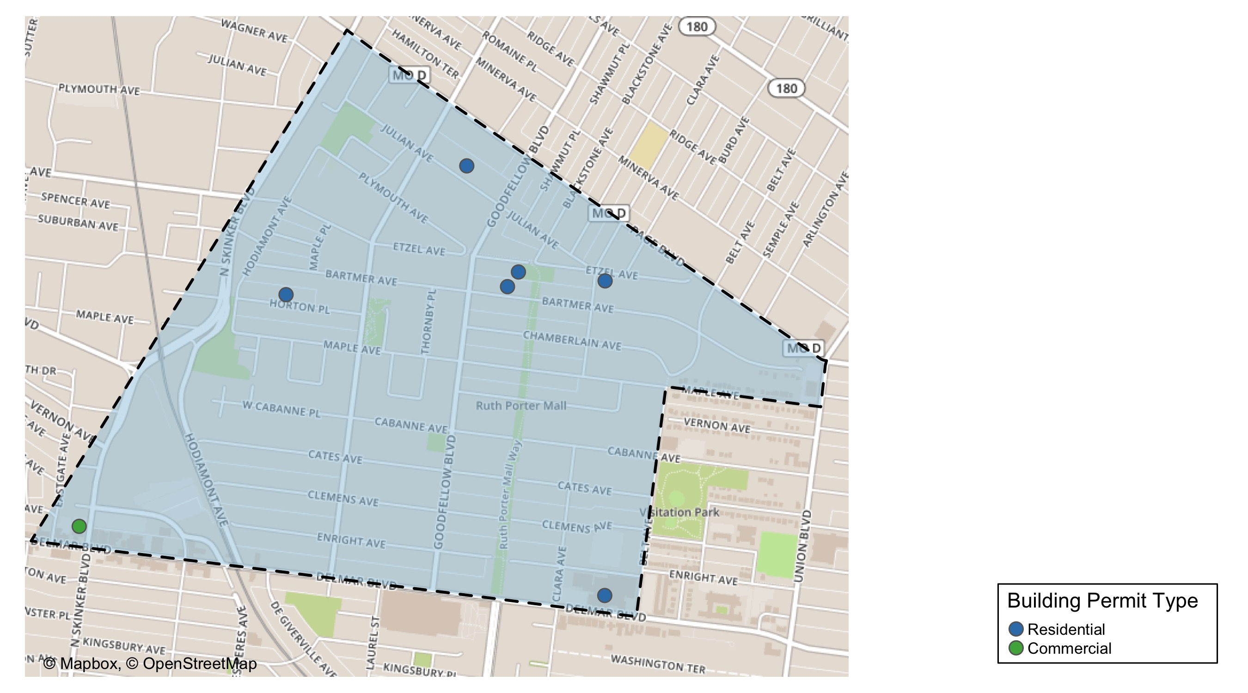
West End

Slide 30
West End
January 2021 | January 2021 | January 2021 | January 2021
Permit Use | Average Cost | # of Permits | Total Value of Permits
Commercial | 4,000.0 | 1.0 | 4,000.0
Industrial | 0.0 | 0.0 | 0.0
Institutional | 0.0 | 0.0 | 0.0
Residential | 117,527.8 | 6.0 | 705,167.0
Last 6 Months | Last 6 Months | Last 6 Months | Last 6 Months
Permit Use | Average Cost | # of Permits | Total Value of Permits
Commercial | 26,547.8 | 9.0 | 238,930.0
Industrial | 0.0 | 0.0 | 0.0
Institutional | 521,017.5 | 2.0 | 1,042,035.0
Residential | 75,211.1 | 40.0 | 3,008,442.0

Slide 31
West End Individual Permit Breakdown
Owner | New Use | Cost | Address
PURNELL, JOANIE D | Residential | 9,500.0 | 6015 HORTON PL
DELMAR DIVINE MASTER LANDLORD COMMER | Residential | 590,847.0 | 5535 DELMAR BLVD
OLIVER, LINDA S | Residential | 68,000.0 | 5716 ETZEL AV
CARADINE, LAVELL | Residential | 4,700.0 | 5727 BARTMER AV
PACE-DELMAR ASSOCIATES LLC | Commercial | 4,000.0 | 6217 DELMAR BLVD
DENT, VAUGHN J | Residential | 8,520.0 | 5598 ETZEL AV
WILLIAMS, JOSEPH & ANN | Residential | 23,600.0 | 5853 JULIAN AV

Slide 32
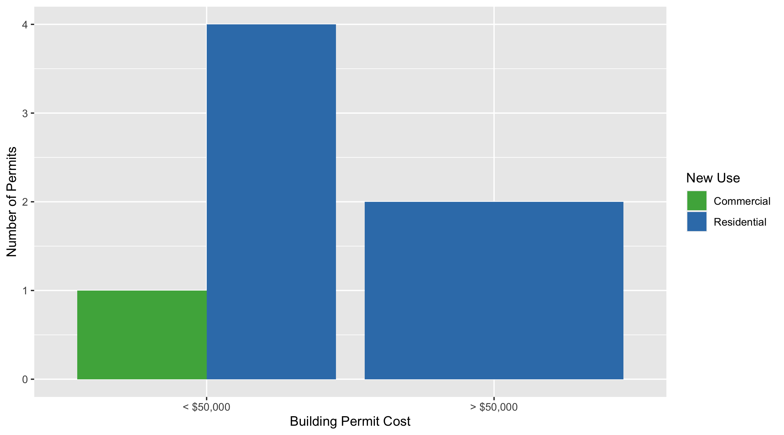
West End Permit Cost Breakdown

Slide 33
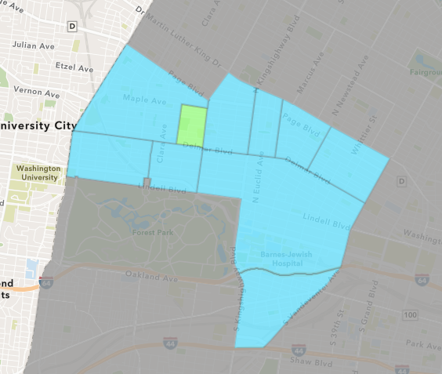
Visitation Park
January 2021 Neighborhood Cost Breakdown
Mean: $0
Median: NA
Range: $0 - $0

Slide 34
Visitation Park: Summary Notes
0 building permits in January 2021
0.00% change compared to January 2020 (0 total building permits)
$0: Average building permit cost in January 2021
0.00% change compared to January 2020 ($0)
0 total building permits in 2021
0.00% change YTD compared to this time in 2020 (0 total building permits)
$0: YTD average building permit cost in 2021
0.00% change YTD compared to this time in 2020 ($0)

Slide 35
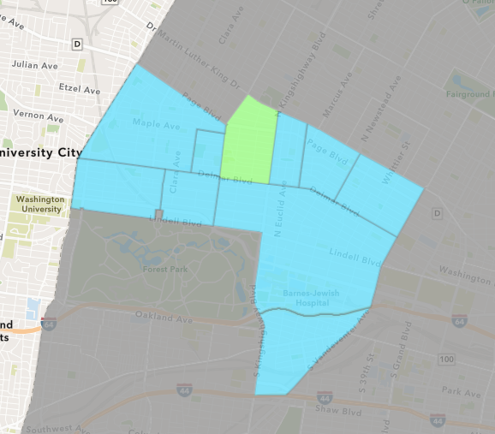
Academy
January 2021 Neighborhood Cost Breakdown
Mean: $4,475
Median: $4,475
Range: $4,475 - $4,475

Slide 36
Academy: Summary Notes
1 building permits in January 2021
-83.33% change compared to January 2020 (6 total building permits)
$4,475: Average building permit cost in January 2021
-94.79% change compared to January 2020 ($85,825)
1 total building permits in 2021
-83.33% change YTD compared to this time in 2020 (6 total building permits)
$4,475: YTD average building permit cost in 2021
-94.79% change YTD compared to this time in 2020 ($85,825)

Slide 37
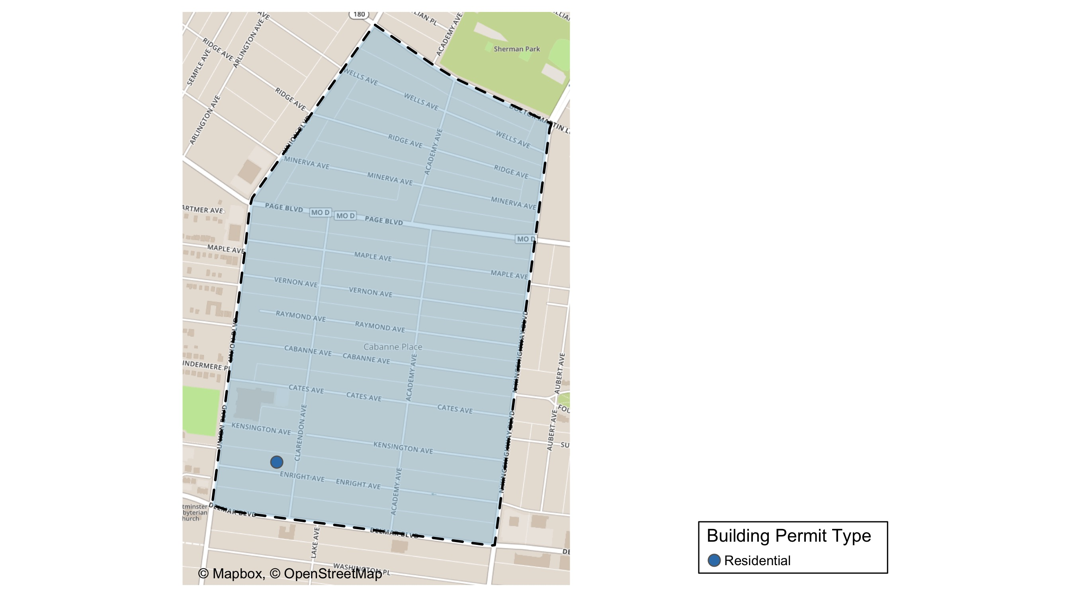
Academy

Slide 38
Academy
January 2021 | January 2021 | January 2021 | January 2021
Permit Use | Average Cost | # of Permits | Total Value of Permits
Commercial | 0.0 | 0.0 | 0.0
Industrial | 0.0 | 0.0 | 0.0
Institutional | 0.0 | 0.0 | 0.0
Residential | 4,475.0 | 1.0 | 4,475.0
Last 6 Months | Last 6 Months | Last 6 Months | Last 6 Months
Permit Use | Average Cost | # of Permits | Total Value of Permits
Commercial | 15,000.0 | 1.0 | 15,000.0
Industrial | 0.0 | 0.0 | 0.0
Institutional | 5,250.0 | 2.0 | 10,500.0
Residential | 27,702.2 | 20.0 | 554,044.0

Slide 39
Academy Individual Permit Breakdown
Owner | New Use | Cost | Address
SYMS, MELBA DEE JOHNSON | Residential | 4,475.0 | 5217 ENRIGHT AV

Slide 40
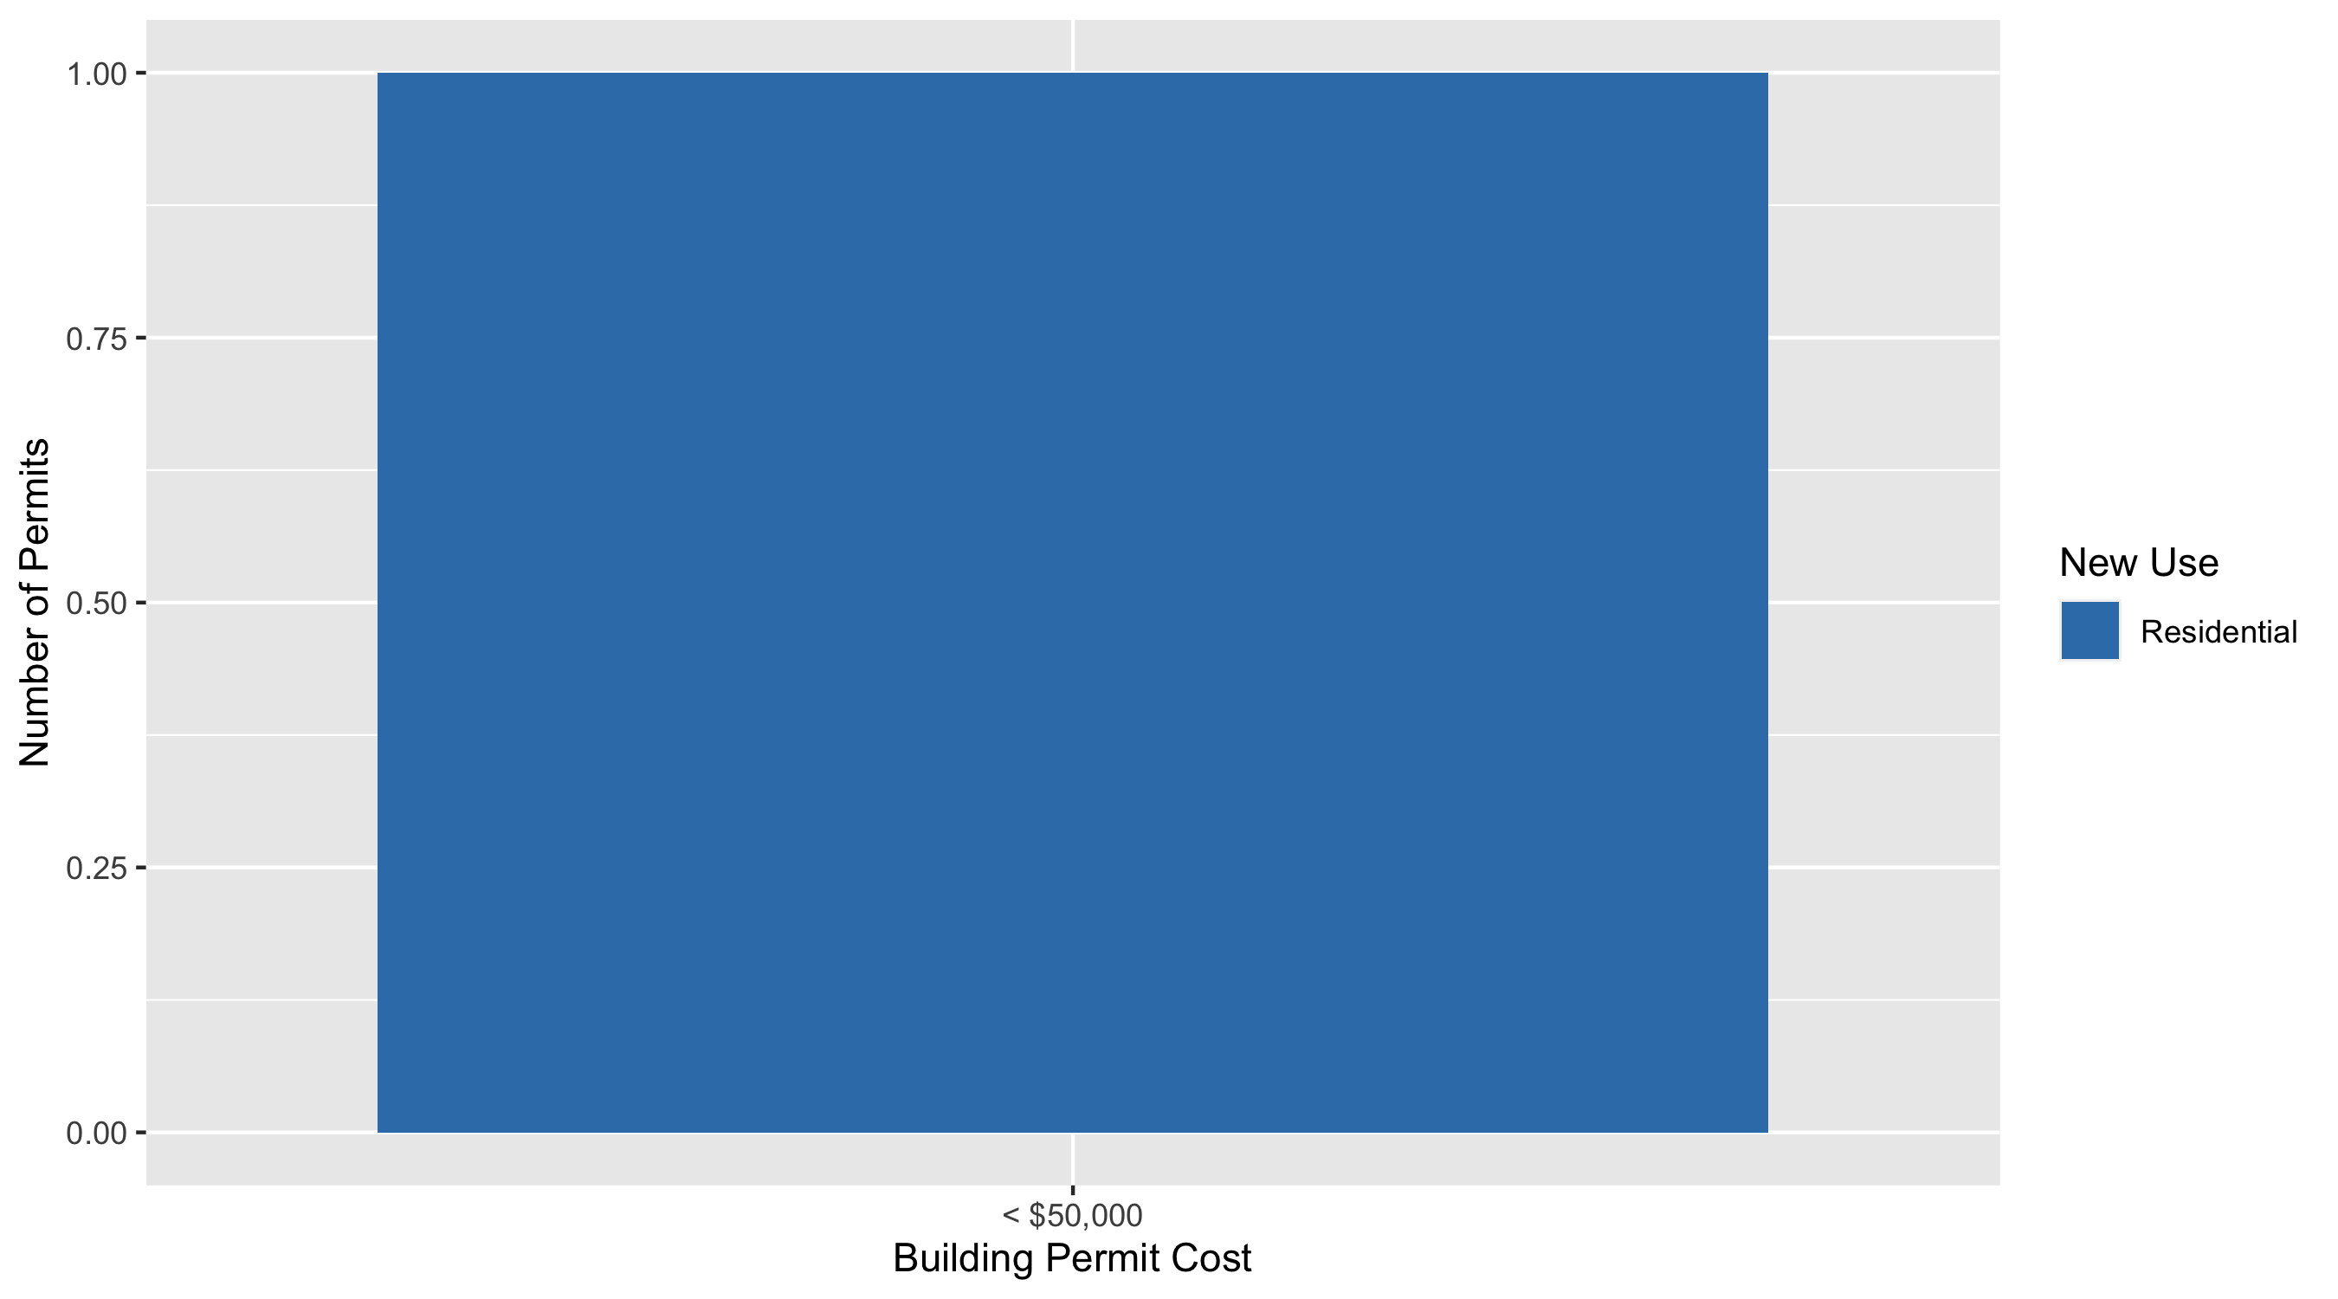
Academy Permit Cost Breakdown

Slide 41
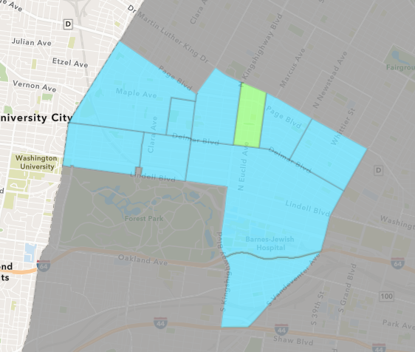
Fountain Park
January 2021 Neighborhood Cost Breakdown
Mean: $0
Median: NA
Range: $0 - $0

Slide 42
Fountain Park: Summary Notes
0 building permits in January 2021
0.00% change compared to January 2020 (0 total building permits)
$0: Average building permit cost in January 2021
0.00% change compared to January 2020 ($0)
0 total building permits in 2021
0.00% change YTD compared to this time in 2020 (0 total building permits)
$0: YTD average building permit cost in 2021
0.00% change YTD compared to this time in 2020 ($0)

Slide 43
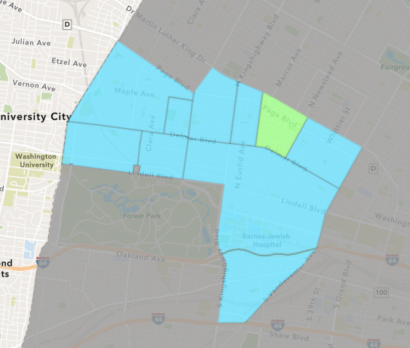
Lewis Place
January 2021 Neighborhood Cost Breakdown
Mean: $54,867
Median: $8,600
Range: $6,000 - $150,000

Slide 44
Lewis Place: Summary Notes
3 building permits in January 2021
200.00% change compared to January 2020 (1 total building permits)
$54,867: Average building permit cost in January 2021
2094.67% change compared to January 2020 ($2,500)
3 total building permits in 2021
200.00% change YTD compared to this time in 2020 (1 total building permits)
$54,867: YTD average building permit cost in 2021
2094.67% change YTD compared to this time in 2020 ($2,500)

Slide 45
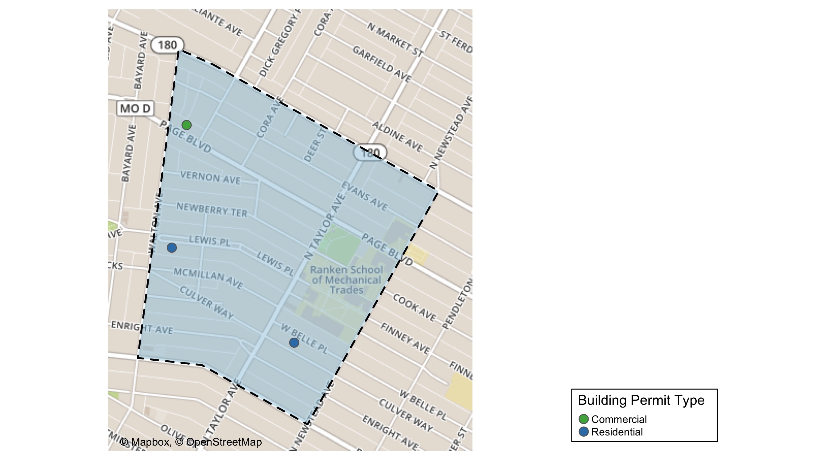
Lewis Place

Slide 46
Lewis Place
January 2021 | January 2021 | January 2021 | January 2021
Permit Use | Average Cost | # of Permits | Total Value of Permits
Commercial | 6,000.0 | 1.0 | 6,000.0
Industrial | 0.0 | 0.0 | 0.0
Institutional | 0.0 | 0.0 | 0.0
Residential | 79,300.0 | 2.0 | 158,600.0
Last 6 Months | Last 6 Months | Last 6 Months | Last 6 Months
Permit Use | Average Cost | # of Permits | Total Value of Permits
Commercial | 8,000.0 | 2.0 | 16,000.0
Industrial | 0.0 | 0.0 | 0.0
Institutional | 10,000.0 | 1.0 | 10,000.0
Residential | 37,880.2 | 14.0 | 530,323.0

Slide 47
Lewis Place Individual Permit Breakdown
Owner | New Use | Cost | Address
TAYLOR, GERRY & ROBYN | Commercial | 6,000.0 | 4721 PAGE BLVD
THOMAS, BRENDA | Residential | 8,600.0 | 4734 LEWIS PL
RANKEN TECHNICAL COLLEGE | Residential | 150,000.0 | 4458 WEST BELLE PL

Slide 48
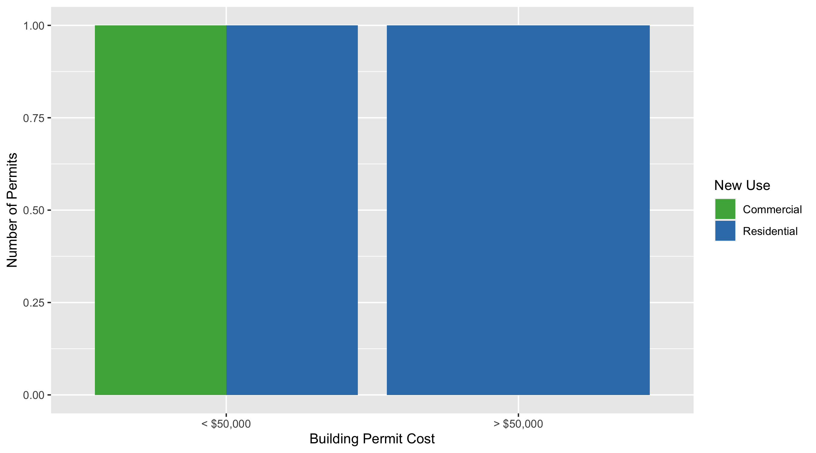
Lewis Place Permit Cost Breakdown

Slide 49
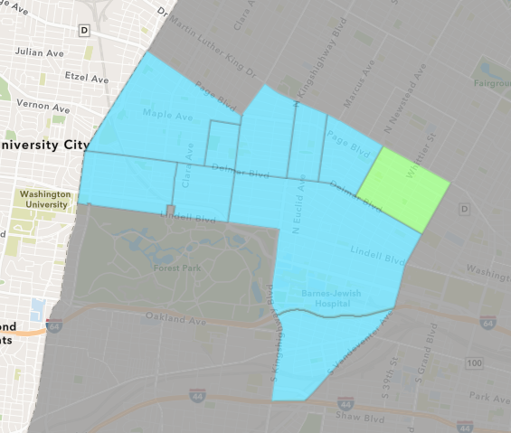
Vandeventer
January 2021 Neighborhood Cost Breakdown
Mean: $0
Median: NA
Range: $0 - $0

Slide 50
Vandeventer: Summary Notes
0 building permits in January 2021
-100.00% change compared to January 2020 (2 total building permits)
$0: Average building permit cost in January 2021
-100.00% change compared to January 2020 ($102,500)
0 total building permits in 2021
-100.00% change YTD compared to this time in 2020 (2 total building permits)
$0: YTD average building permit cost in 2021
-100.00% change YTD compared to this time in 2020 ($102,500)

Slide 51
Additional Notes
Data retreived from https://www.stlouis-mo.gov/data/
Building permits with a cost of $0 were dropped
Building permits that were cancelled were dropped
Infinite change indicates 0 permits in the current or previous time period/comparison month so there was a overall increase or decrease

